Slide 1

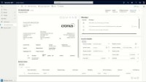
TECHNOLOGY UNIFICATION
Enable effective business processes with unified apps and data
AI Builder Document Automation
Invoice Scanning and Recognition through AI Builder Form Processing Models
Automatically submit invoices for approval through workflow
Intelligent workflow alerting using Power Automate and Business Events
Invoice status visibility
AP Invoice Capture and OCR

